Slide 1
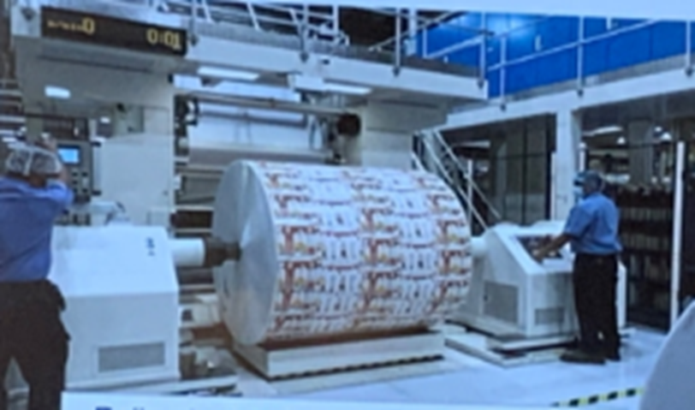
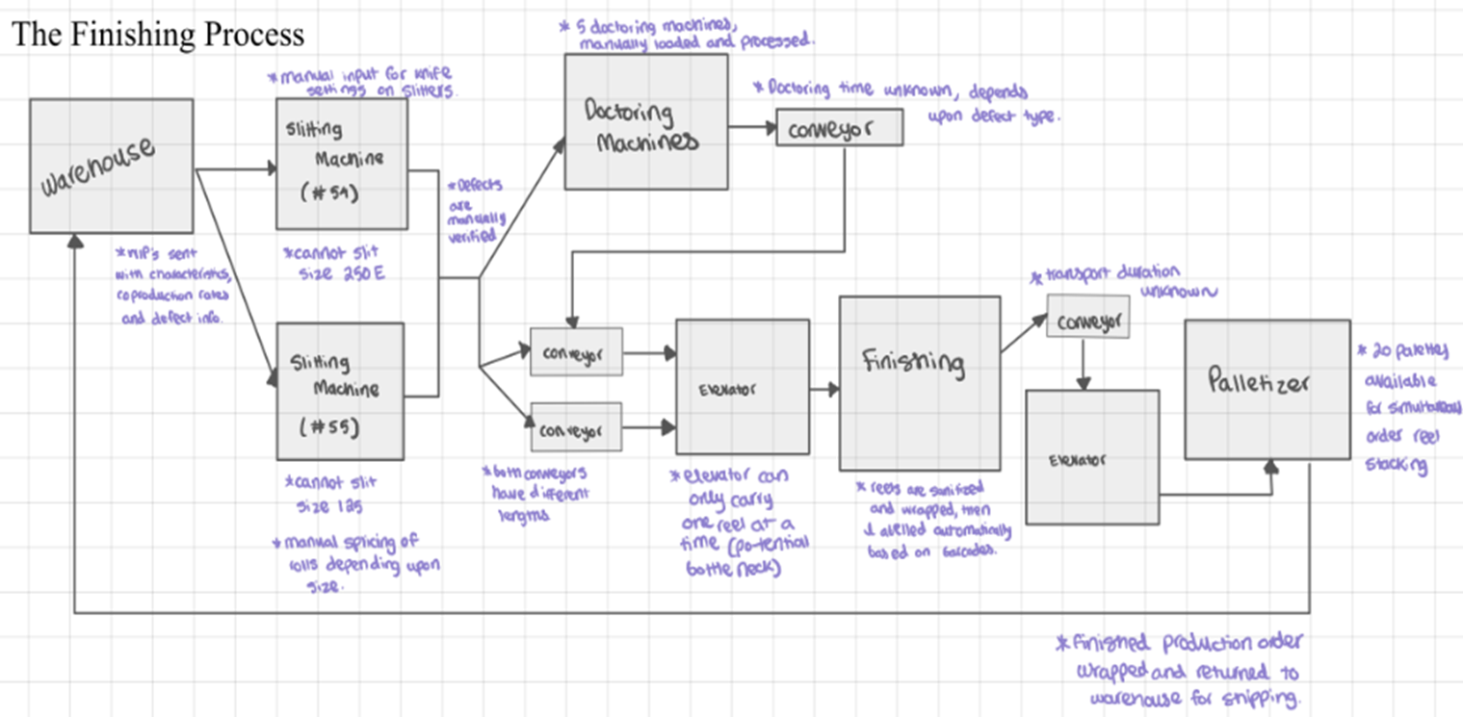
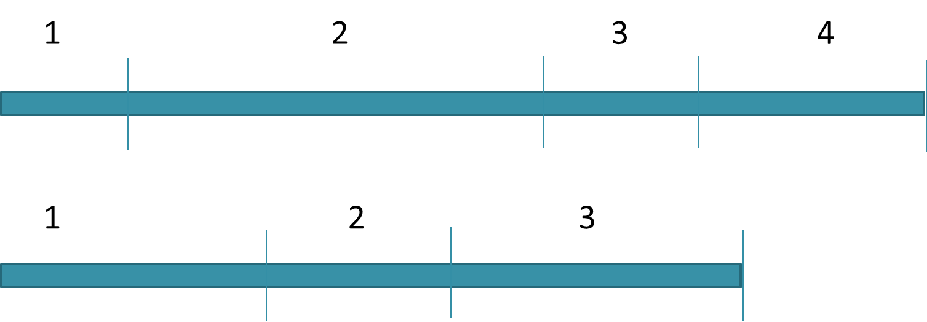
Automated Finishing Process Scheduler
Arushi Agrawal Heidi Shaffer Mitali Shenoy Micah Wallis
Goal
To design a scheduling algorithm that suggests an improved input order for roll insertion into the two slitting machines. The algorithm attempts to increase on-time order deliveries by reducing bottlenecks caused by human error during manual planning.
* All team members contributed equally
Approach
Timeline based scheduling algorithm using doubly linked lists
Compatibility scoring system to analyze simultaneously scheduled orders
Date range buckets for earliest deadline first scheduling
Architecture
Excel inputs -> Python 3 script -> Excel outputs
Pandas DataFrames and Tkinter GUI
Custom doubly linked lists
Acknowledgement:
We would like to thank Dr. Bhadrachalam Chitturi (technical mentor) and Juan Carlos (TetraPak Sponsor) for their support, guidance, insight, enthusiasm during this project.
Abstract
Abstract
Compatibility Score
Estimated Machine Runtime
Estimated Machine Runtime
Machine Restrictions and Constraints

