Slide 1
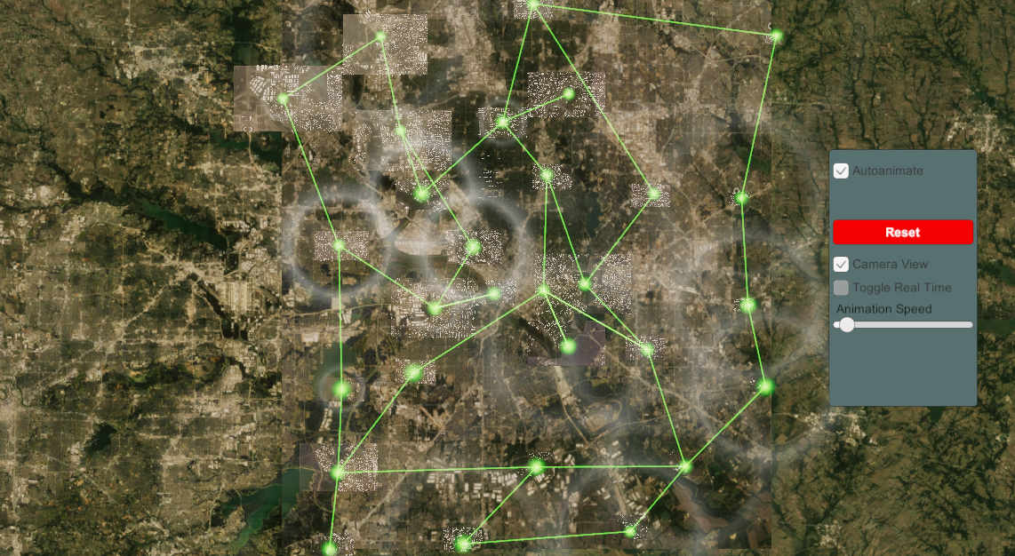
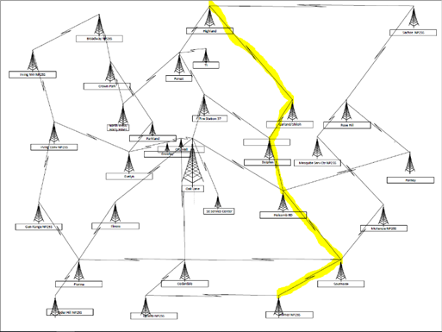
Digital Twin - P25 Public Safety Radio Network
Eldyn Castillo, Eric Cutherell, Nishanth Lam, Vishnu Yarabarla, Jarrett Bigley, Alan-Alvarado-Camacho
Goal: Create a digital simulation the P25 network. This is a network used by emergency responders throughout the city of Dallas to communicate. The model should show relevant radio tower locations and clearly illustrate a main and backup signal pathway propagation using animations.
Approach: Relevant Model of the city created using blender and GIS. Animations that simulation the network paths made using Unity. UI to control animations done with Unity Canvas.
Features:
3D map of city of Dallas with relevant Radio Towers
Animation of main radio pathway
Animation of backup radio pathway
Custom speed slider for animations
Canvas UI to easily choose animations
Multiple camera angles

